Slide 1
Statistical Study of Fast Radio Burst Population
Murthadza bin Aznam (S2163122)

Slide 2
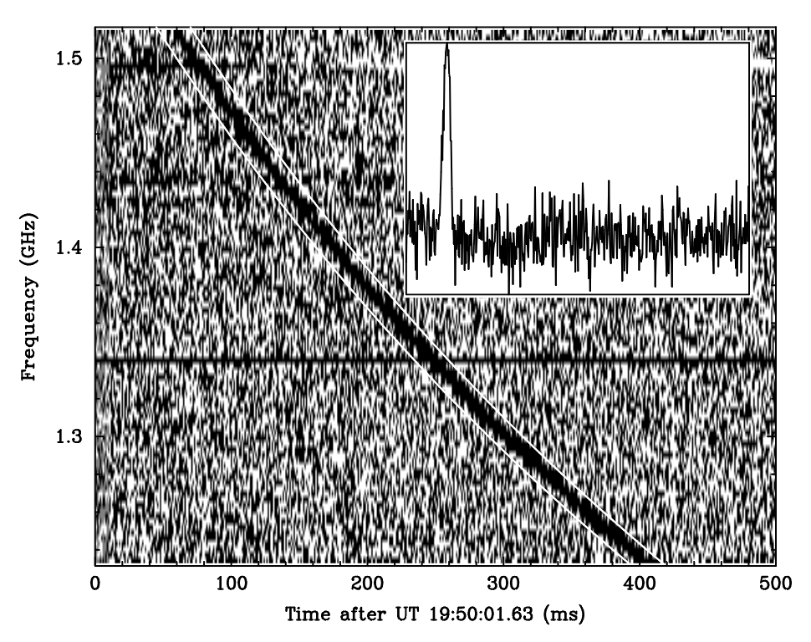
What is Fast Radio Bursts?
Fast Radio Bursts are characterized as a radio signal with short bursts (milliseconds long) and high dispersion measure.
It was first identified by Lorimer et al. (2007) in the archival data for pulsar surveys.
It is brighter and much further away than pulsars.
Figure 1: The burst that Lorimer had seen (Lorimer et al. 2007)
Notes:
About 40 years since the discovery of pulsars in 1968, Duncan R. Lorimer found an intriguing burst in the archival data of pulsar surveys collected by the Parkes Telescope. Compared to the pulsars which was already extensively studied, this burst is highly energetic and its distance suggested that it is of extra-galactic origin. Lorimer concluded that it is a different phenomenon and it was informally known as a Lorimer Burst.
Later searches for similar signal came to the same conclusion. This milliseconds long signal with high dispersion measure is came to be known as ‘fast radio bursts’ (FRBs). Currently, there is over 800 detections of this burst with many more expected to be detected.

Slide 3
Detections
Subsequent detections from various telescopes confirms it is indeed an astronomical phenomena (Petroff, Hessels, and Lorimer 2019).
The name ‘fast radio burst’ was first introduced by Thornton et al. (2013).
The CHIME/FRB telescope has detected 536 events (The CHIME/FRB Collaboration et al. 2021).
The BURSTT telescope (Lin et al. 2022) is planned to be commisioned soon to capture more detections.

Slide 4
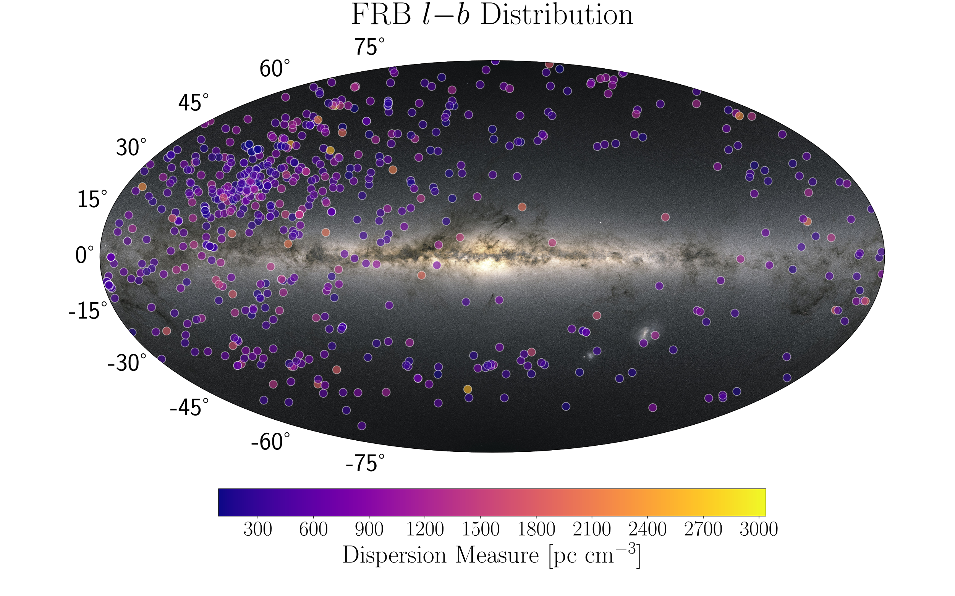
Figure 2: The distribution of FRBs across the night sky (Spanakis-Misirlis 2021).

Slide 5
Theories
Multiple theories have been presented on the origins of FRBs (Petroff, Hessels, and Lorimer 2019), including:
Highly magnetized neutron stars (magnetars).
Interacting neutron stars.
Interacting black holes.
However, the origin of FRBs remain inconclusive.

Slide 6
Research Questions
Is it possible that there are subsets within the population of known FRBs?
What properties differentiates FRBs into differing subsets?
How does these subsets affect the predictions of FRB detections?
Notes:
Panel comment: Do not forget to add objectives.

Slide 7
Literature Review
Classification
Repeating FRB
Morphology Archetype
Using Machine Learning
Star Formation History

Slide 8
Literature Review
Classification: Repeating FRB
The first repeating FRB was found in Spitler et al. (2016).
The CHIME/FRB Collaboration et al. (2021) records 18 repeating sources from 492 FRB sources.
Multiple statistical analyses show consistent differences between repeating and non-repeating FRB in various properties (Cui et al. 2021; Chen et al. 2022; K. Zhang et al. 2022).
Are all FRBs repeating, or only some of them do?

Slide 9
Literature Review
Classification: Morphology Archetype
Pleunis et al. (2021) identified four shapes:
Broadband simple bursts (30%)¹
Narrowband simple bursts (60%)
Complex bursts with similar frequency extent (5%)
Complex bursts with subbursts that drift downward in frequency (5%)

Slide 10
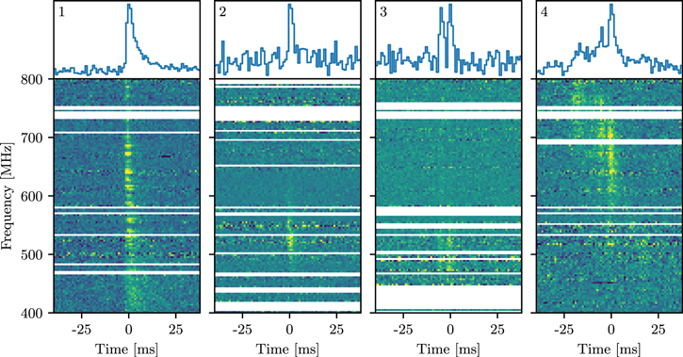
Figure 3: Single examples of each archetype numbered accordingly (Pleunis et al. 2021).
Notes:
A broadband and single-peaked morphology has so far never been clearly observed in a repeater burst
There is a lot of downward-drifting subbursts among repeater bursts (19/58 bursts among 13/19 sources)
Non-repeaters with similar structutre with repeaters have a possibility to repeat.

Slide 11
Literature Review
Classification: Using Machine Learning
Bo Han Chen et al. (2021) and Zhu-Ge, Luo, and Zhang (2022) used dimensional reduction (unsupervised learning) to map multiple features of FRB into 2D.
They found that repeaters tend to clump together (i.e. they have similar features).
They concluded that non-repeaters that clump together with repeaters have latent repeaters properties and may repeat.
Luo, Zhu-Ge, and Zhang (2022) used classification algorithm (supervised machine learning) to see how a machine predicts the repeatability of FRBs. Non-repeaters that are consistently ‘mislabelled’ as repeating have similar feature with repeaters.

Slide 12
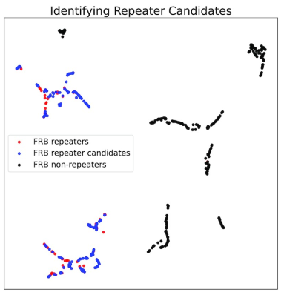
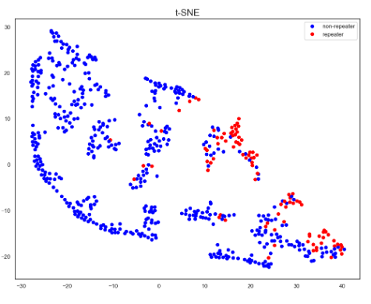
Figure 4: A 2D projection space for 13 features of FRBs using the UMAP algorithm and the grouping is identified using HDBSCAN (Bo Han Chen et al. 2021)
Figure 5: A 2D projection space for 10 features of FRBs using the t-SNE algorithm and the grouping is identified using HDBSCAN (Zhu-Ge, Luo, and Zhang 2022)

Slide 13
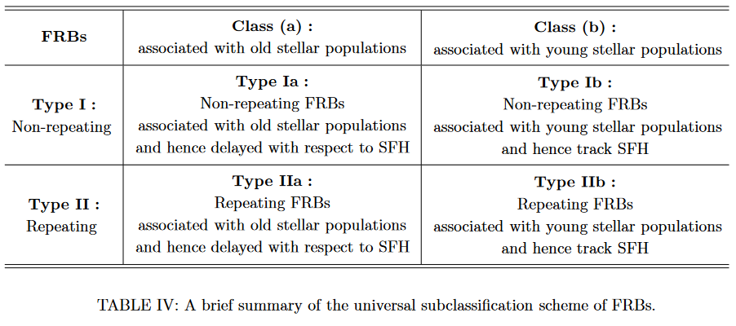
Literature Review
Classification: Star Formation History
R. C. Zhang and Zhang (2022) and Qiang, Li, and Wei (2022) found that the whole population of FRBs do not track star formation history.
Guo and Wei (2022) suggestes that only some of the FRBs track star formation history, proposing a subclassification in figure 6.
Guo and Wei (2022)’s is still highly speculative with little evidence supporting this.
Figure 6: The FRB classsification scheme proposed by Guo and Wei (2022) based on repeatability and its association with stellar population.

Slide 14
Literature Review
Predicting Repeatability
The works described in Morphology Archetype and Using Machine Learning have a goal of using those methods to predict repeatability.
Both sections suggest that non-repeaters with repeater-like features might actually be repeaters.
These predictions can be compared using the newly released data catalogue, CHIME/FRB 2023 Catalog (Andersen et al. 2023).
Related to the question: “Are all FRBs repeating, or only some of them do?”

Slide 15
Literature Review
Feature Importance
Machine Learning results show several important features:
frequency range and peak frequency of the FRB subburst is consistently ranked high in importance across all three studies (Cui et al. 2021; Chen et al. 2022; K. Zhang et al. 2022)
scattering time, fluence and flux are ranked high in Bo Han Chen et al. (2021) while brightness temperature is ranked high in Luo, Zhu-Ge, and Zhang (2022).
Statistical analyses found differences between repeaters and non-repeaters with regards to temporal pulse width (Cui et al. 2021; Chen et al. 2022), dispersion measure (K. Zhang et al. 2022), and luminosity (Cui et al. 2021; Chen et al. 2022)

Slide 16
Methodology
Data Sources
FRBCAT / Transient Naming Server
CHIME/FRB Catalog 1
FRBSTATS
CHIME/FRB 2023 Catalog

Slide 17
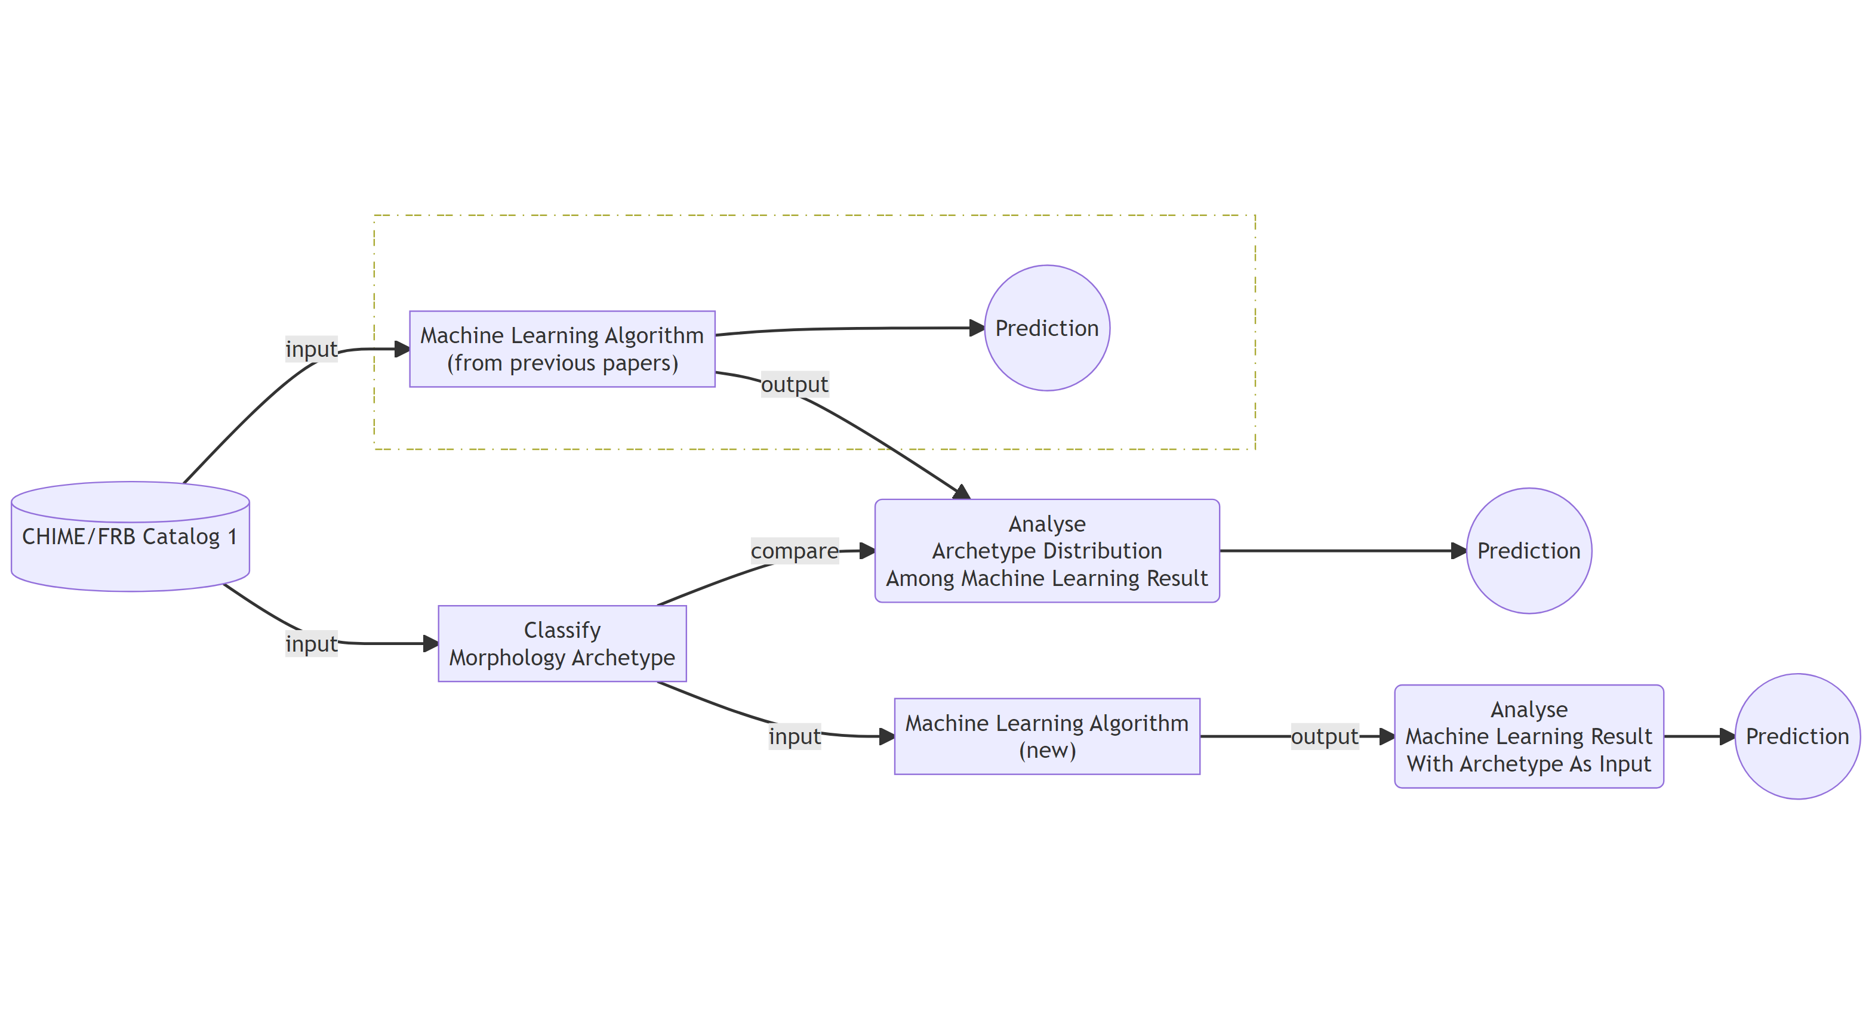
Methodology
Framework
Proposed workflow to combine morphological archetypes with machine learning results.

Slide 18
References
Andersen, B. C., K. Bandura, M. Bhardwaj, P. J. Boyle, C. Brar, T. Cassanelli, S. Chatterjee, et al. 2023. “CHIME/FRB Discovery of 25 Repeating Fast Radio Burst Sources.” The Astrophysical Journal 947 (January): 83. https://doi.org/10.3847/1538-4357/acc6c1.
Bo Han Chen, Tetsuya Hashimoto, Tomotsugu Goto, Seong Jin Kim, Daryl Joe D. Santos, Alvina Y. L. On, Ting-Yi Lu, and Tiger Y. -Y. Hsiao. 2021. “Uncloaking Hidden Repeating Fast Radio Bursts with Unsupervised Machine Learning.” Monthly Notices of the Royal Astronomical Society 509 (1): 1227–36. https://doi.org/10.1093/mnras/stab2994.
Chen, Hao-Yan, Wei-Min Gu, Mouyuan Sun, and Tuan Yi. 2022. “One-Off and Repeating Fast Radio Bursts: A Statistical Analysis.” The Astrophysical Journal 939 (November): 27. https://doi.org/10.3847/1538-4357/ac958a.
Cui, Xiang-Han, Cheng-Min Zhang, Shuang-Qiang Wang, Jian-Wei Zhang, Di Li, Bo Peng, Wei-Wei Zhu, et al. 2021. “Statistical Properties of Fast Radio Bursts Elucidate Their Origins: Magnetars Are Favored over Gamma-Ray Bursts.” Research in Astronomy and Astrophysics 21 (8): 211. https://doi.org/10.1088/1674-4527/21/8/211.
Guo, Han-Yue, and Hao Wei. 2022. “A Possible Subclassification of Fast Radio Bursts.” Journal of Cosmology and Astroparticle Physics 2022 (July): 010. https://doi.org/10.1088/1475-7516/2022/07/010.
Lin, Hsiu-Hsien, Kai-yang Lin, Chao-Te Li, Yao-Huan Tseng, Homin Jiang, Jen-Hung Wang, Jen-Chieh Cheng, et al. 2022. “BURSTT: Bustling Universe Radio Survey Telescope in Taiwan.” Publications of the Astronomical Society of the Pacific 134 (September): 094106. https://doi.org/10.1088/1538-3873/ac8f71.
Lorimer, D. R., M. Bailes, M. A. McLaughlin, D. J. Narkevic, and F. Crawford. 2007. “A Bright Millisecond Radio Burst of Extragalactic Origin.” Science 318 (5851): 777–80. https://doi.org/10.1126/science.1147532.
Luo, Jia-Wei, Jia-Ming Zhu-Ge, and Bing Zhang. 2022. “Machine Learning Classification of CHIME Fast Radio Bursts: I. Supervised Methods.” Monthly Notices of the Royal Astronomical Society, November, stac3206. https://doi.org/10.1093/mnras/stac3206.
Petroff, E., J. W. T. Hessels, and D. R. Lorimer. 2019. “Fast Radio Bursts.” The Astronomy and Astrophysics Review 27 (1): 4. https://doi.org/10.1007/s00159-019-0116-6.
Pleunis, Ziggy, Deborah C. Good, Victoria M. Kaspi, Ryan Mckinven, Scott M. Ransom, Paul Scholz, Kevin Bandura, et al. 2021. “Fast Radio Burst Morphology in the First CHIME/FRB Catalog.” The Astrophysical Journal 923 (1): 1. https://doi.org/10.3847/1538-4357/ac33ac.
Qiang, Da-Chun, Shu-Ling Li, and Hao Wei. 2022. “Fast Radio Burst Distributions Consistent with the First CHIME/FRB Catalog.” Journal of Cosmology and Astroparticle Physics 2022 (01): 040. https://doi.org/10.1088/1475-7516/2022/01/040.
Spanakis-Misirlis, Apostolos. 2021. “FRBSTATS: A Web-Based Platform for Visualization of Fast Radio Burst Properties.” Astrophysics Source Code Library, June, ascl:2106.028. https://ui.adsabs.harvard.edu/abs/2021ascl.soft06028S.
Spitler, L. G., P. Scholz, J. W. T. Hessels, S. Bogdanov, A. Brazier, F. Camilo, S. Chatterjee, et al. 2016. “A Repeating Fast Radio Burst.” Nature 531 (7593): 202–5. https://doi.org/10.1038/nature17168.
The CHIME/FRB Collaboration, Mandana Amiri, Bridget C. Andersen, Kevin Bandura, Sabrina Berger, Mohit Bhardwaj, Michelle M. Boyce, et al. 2021. “The First CHIME/FRB Fast Radio Burst Catalog.” The Astrophysical Journal Supplement Series 257 (2): 59. https://doi.org/10.3847/1538-4365/ac33ab.
Thornton, D., B. Stappers, M. Bailes, B. Barsdell, S. Bates, N. D. R. Bhat, M. Burgay, et al. 2013. “A Population of Fast Radio Bursts at Cosmological Distances.” Science 341 (6141): 53–56. https://doi.org/10.1126/science.1236789.
Zhang, Kongjun, Longbiao Li, Zhibin Zhang, Qinmei Li, Juanjuan Luo, and Min Jiang. 2022. “The Statistical Similarity of Repeating and Non-Repeating Fast Radio Bursts.” Universe 8 (7): 355. https://doi.org/10.3390/universe8070355.
Zhang, Rachel C., and Bing Zhang. 2022. “The CHIME Fast Radio Burst Population Does Not Track the Star Formation History of the Universe.” arXiv. https://doi.org/10.48550/arXiv.2109.07558.
Zhu-Ge, Jia-Ming, Jia-Wei Luo, and Bing Zhang. 2022. “Machine Learning Classification of Fast Radio Bursts: II. Unsupervised Methods.” arXiv. https://doi.org/10.48550/arXiv.2210.02471.

Slide 19
Notes
1. the percentages are estimated by eye

